Slide 1
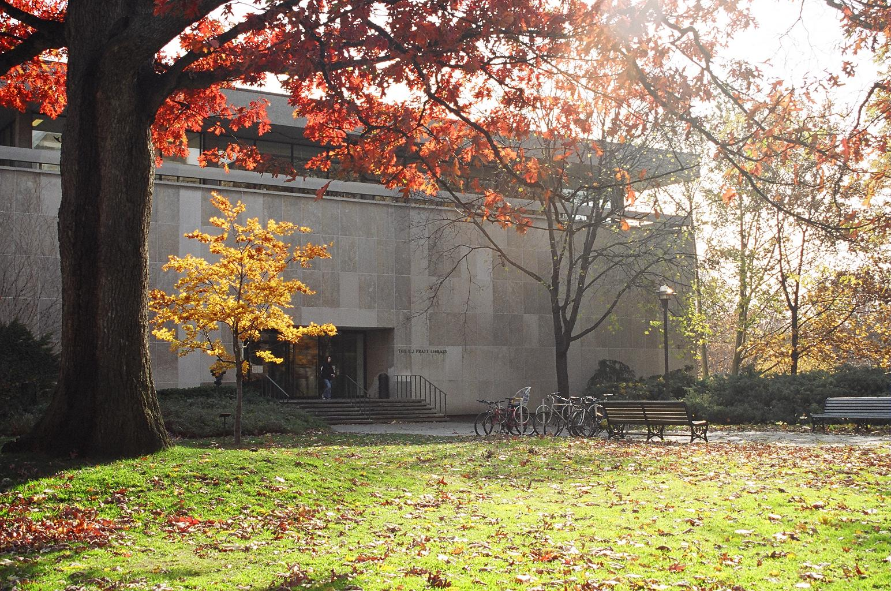
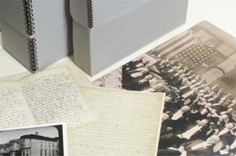
ARCHIVES AND Special collections
2018 Scholars In Residence Program
Agatha barc and Roma Kail,
Victoria university library

Slide 2
Archives and Special Collections
Traditional mandate for an Archives is to acquire, appraise, select, preserve and make available records of enduring value for use, memory, research, or evidence – records include all media types from public and/or private organizations, families, or persons
Special Collections vary by institution:
at Vic: includes rare books, published material and archival fonds specifically chosen for preservation to support research and programs
Elsewhere: includes rare books, maps, posters, literary manuscripts and authors’ papers

Slide 3
Archives as records
created in the conduct of affairs
residue of their creator(s) functions or activities
deemed to have enduring value: information, evidence, legal, historical
SAA Glossary

Slide 4
Archives as Place
An Institutional Archives: a division responsible for maintaining the organization's records of enduring value
A Collecting Archives: an organization that collects records of individuals, families, or other organizations
SAA Glossary

Slide 5
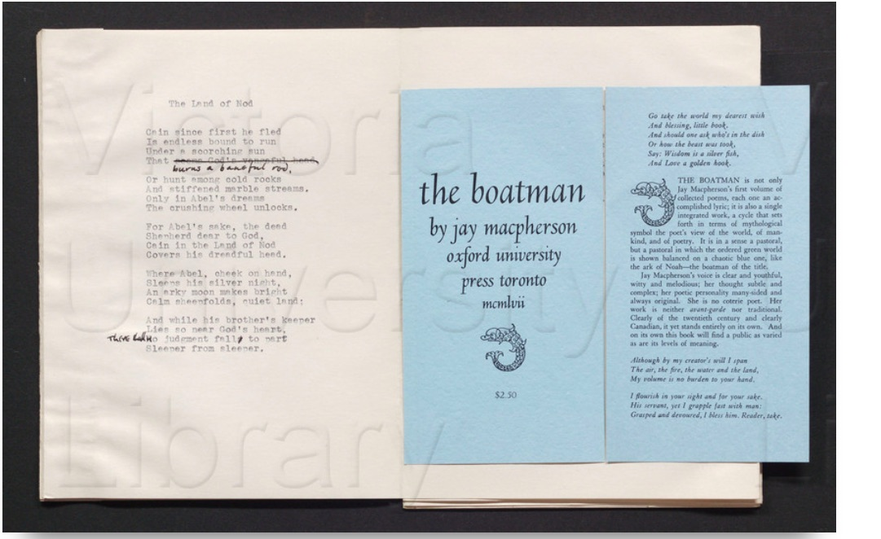
Jay MacPherson Fonds

Slide 6
Jay MacPherson Fonds
Jay Macpherson Finding Aid

Slide 7
Hierarchical Description

Slide 8
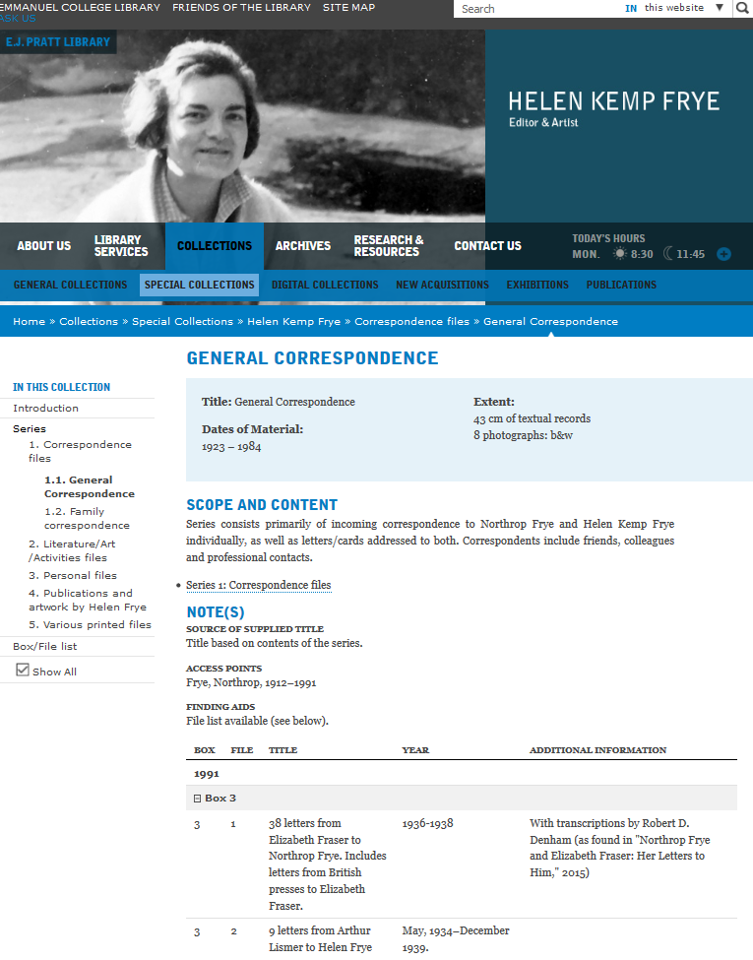
HOW TO USE A FINDING AID
FONDS - HELEN KEMP FRYE FONDS
SERIES NUMBER/NAME
1. CORRESPONDENCE
SUB-SERIES NUMBER/NAME
1.1. GENERAL CORRESPONDENCE
BOX NUMBER /FILE NUMBER/NAME -
1991- Box 3, File 1
38 LETTERS FROM
ELIZABETH FRASER TO NORTHROP FRYE – 1936

Slide 9
Jay MacPherson Fonds
Jay Macpherson Finding Aid

Slide 10
Archival literacy
Archival Literacy involves questioning the records and also why they were kept.
Just because a record appears in an archives, does not necessarily mean that it is reliable
Just because personal records do not appear in an archives, does not necessarily mean they were never written; or, they could appear in a different archives.
Can you determine the following:
Who created the document? - not always known
Why did they create the record? - function
What is the historical context (time, place, and situation) within which it was created?
Why was the record kept? By creator, custodian, archivist.
Is there a bias? How is it revealed?
What evidence can this record contribute to my research?
What does the absence of certain records say in this situation?

Slide 11
Libraries and Archives: Differences
Archives | Libraries and Some Special Collections
Closed stacks – your material will be retrieved for you; storage is secure and humidity controlled | Open stacks – you can browse and take items off the shelf on your own
Organized by provenance | Organized by subject
Group of material is described on a number of different levels: fonds level, series level and item level (hierarchy for context) | Material is described on an individual level (e.g. catalogue record for a single book)
You search the finding aid (listing of everything in the fonds) associated with the creator to find relevant records | You search for materials on your subject using an online catalogue

Slide 12
Why use an Archive?
Different types of archives collect different types of records which can inform your research with archival evidence:
Minutes, by-laws, and administrative records – City or Provincial Archives
Records documenting a particular cause or function – Community Archives (i.e. CLGA, AGO)
Posters and marketing – Film, Music Theatre Archives (TIFF, UofT Media Commons, Stratford)
Diaries, correspondence, photographs, and audio-visual records
Notes:
Example: 4th year Jewison students looking a marketing campaigns for movie before and after the release and initial reception

Slide 13
Finding a Relevant Archive
Ask critical questions:
In what functions or activities did the organization or person engage?
What records might have been created?
Who would have created them? preserved them?
Might these documents have survived?
What repositories are most likely to hold them?

Slide 14
ACCESS TOOLS Finding Archives and their Finding Aids
AAO’s ARCHEION (portal for all archival collections across Ontario) - http://www.archeion.ca/
Discover Archives (U of T Archives portal) - https://discoverarchives.library.utoronto.ca/
City of Toronto Archives - https://web.toronto.ca/city-government/accountability-operations-customer-service/access-city-information-or-records/city-of-toronto-archives/
Library and Archives Canada: www.archivescanada.ca
Most institutions have their finding aids online.

Slide 15
Contact the Archivist
Talk ahead of time to the archivist at the archives you plan to use
They can:
confirm that you have chosen an appropriate archives or refer you to one that is more relevant
explain the registration process and other logistical information
assist you in locating and reading their finding aids
assist you in selecting relevant fonds or records

Slide 16
Helpful Links
For Researchers: AAO (Archives Association of Ontario)
Using Archives – A Practial Guide for Researchers: LAC (Library & Archives Canada) - no longer maintained but useful
What is an Archive?: ACA (Association of Canadian Archivists)

Slide 17
Archival Associations
Information in this presentation is taken from definitions and descriptions written by the following associations:
Association of Canadian Archivists (ACA)
Society of American Archivists (SAA)
Library and Archives Canada (LAC)
Archives Association of Ontario (AAO)

Slide 18
Rare Books

Slide 19
Annotated books or Marginalia
Northrop Frye Annotated Collection
Marshall McLuhan
Margaret Atwood
Alice Munroe
S.T. Colederidge Marginalia
Patrick Colquhoun, A Treatise on Indigence . . . . London 1806 (image)
Entry in online Supplement to Marginalia by H.J. Jackson

Slide 20
S.T. Coleridge Collection
Notebooks – flycatcher notebooks
Correspondence – 3 unpublished letters from J.H.Green
Manuscripts – Christabel

Slide 21
STC –Christabel Manuscript

Slide 22
Rare BooK Collections
Rare Books
Literary Annuals
William Blake
Virginia Woolf
See our Special Collections webpage

Slide 23
Thank you
Roma Kail r.kail@utoronto.ca

